Slide 1
A minor project on PADMAWATI BHOJNALYA
BY: Girish kumar & shivam pathria
20MCA1020 & 20MCA1023

Slide 2


Slide 3
About us
The point of creating Padmawati Bhojnalya venture is to put the customary method for taking requests with electronic framework. Another significant purpose behind building up this task is to get ready request rundown reports rapidly and in precise organization anytime of time when required.

Slide 4
Advantages
Makes the ordering process easier
Efficient customer and order management
Monitor your expenses incurred in real time
Free and cheap marketing
Better customer data
The convenience of mobile ordering
Stay ahead of the competition
Greater reach

Slide 5
Objective
To structure a framework that will clearly fulfilled the client assistance.
To build up a framework ready to suit gigantic measure of requests one after another.
To assess its exhibition and worthiness as far as security, ease of use, precision and unwavering quality.
To build up a framework ready to oblige tremendous measure of requests one after another.
To evaluate its performance and acceptability in terms of security, user-friendliness, accuracy and reliability.
To enhance the communication between the client and the server and minimize the time of ordering.

Slide 6
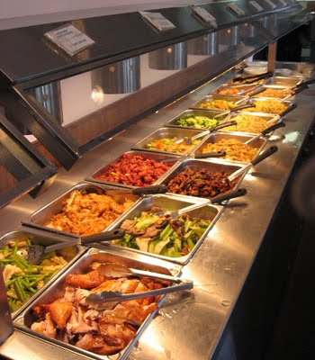
Deliver Fresh food
We always deliver fresh food for the satisfaction of customers

Slide 7
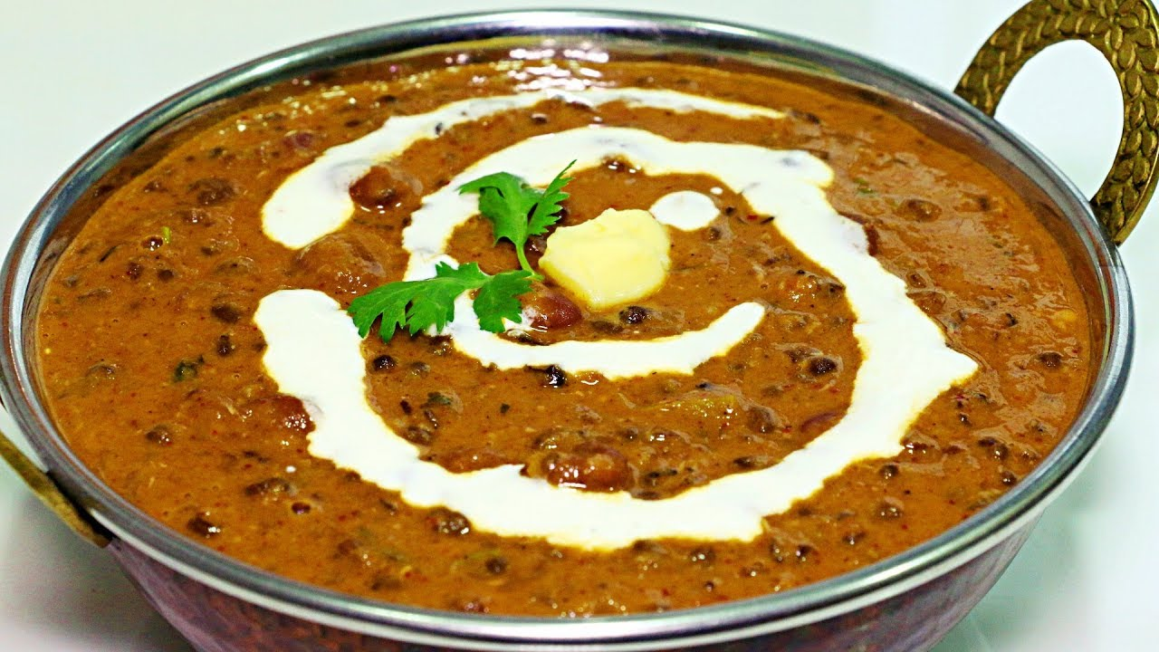
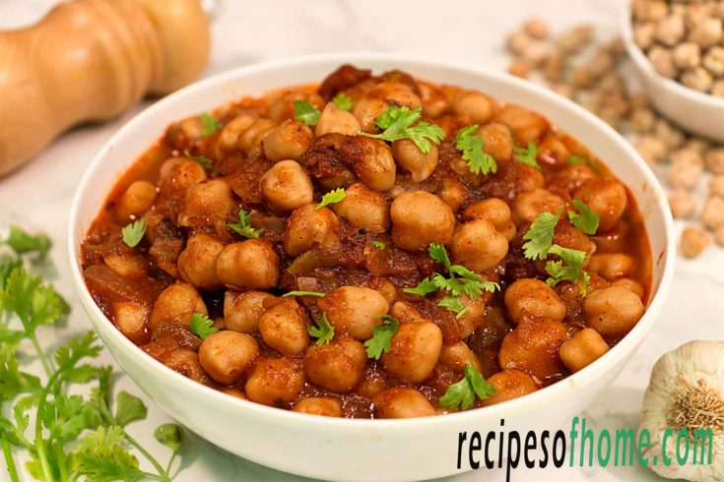
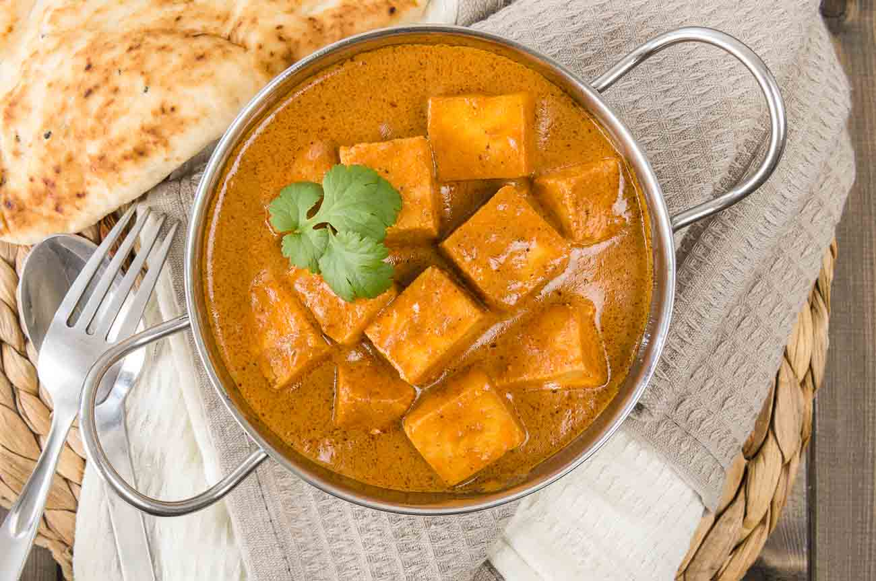

Slide 8
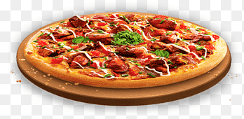
Modules
Employee modules
User modules
Orders modules

Slide 9
Need
Higher Employee Productivity
Order Accuracy
Grow your Business
Ability to Build a Database

Slide 10
System operating costs
Additional equipment (CDs, power supply) maintenances
Program maintenance

Slide 11
System Requirements
XAMPP Server
Text Editor
Browser
Hardware Requirements • RAM: 2GB or More • Processor: 500 MHz or Faster

Slide 12
FUTURE SCOPE
The more the population is increasing with their increased purchasing power the more are the situations of food ordering occurring. Home deliveries are a matter of daily system nowadays for every restaurant big or small in the town..
With the online mobile payment feature ordering food using restaurant based apps has become easier these days. There occurs no requirement to make use of cash. One can order food online using online payment modes right from the restaurant app. •
The ease and convenience of online food ordering using restaurant mobile apps make sure that Tele calling is no longer used for ordering. The more restaurants are adapting to this new technique of food ordering the more the orders coming from phone calls are declining. There is no barrier of language even with the online ordering system.
More and more restaurants are using mobile platforms for food ordering. This means competitiveness is high in the market. As a result, the price of food gets lowered and it is a blessing for the customers

Slide 13
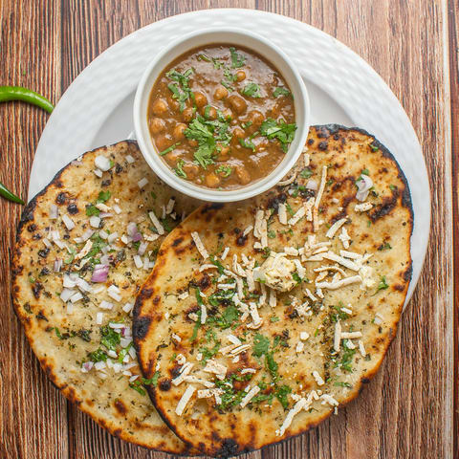

Slide 14
BIBLIOGRAPHY
http://www.google.com
http://www.w3schools.com
http://www.tutorial.com
https://www.dofactory.com
https://www.csstutorial.net

